Slide 1
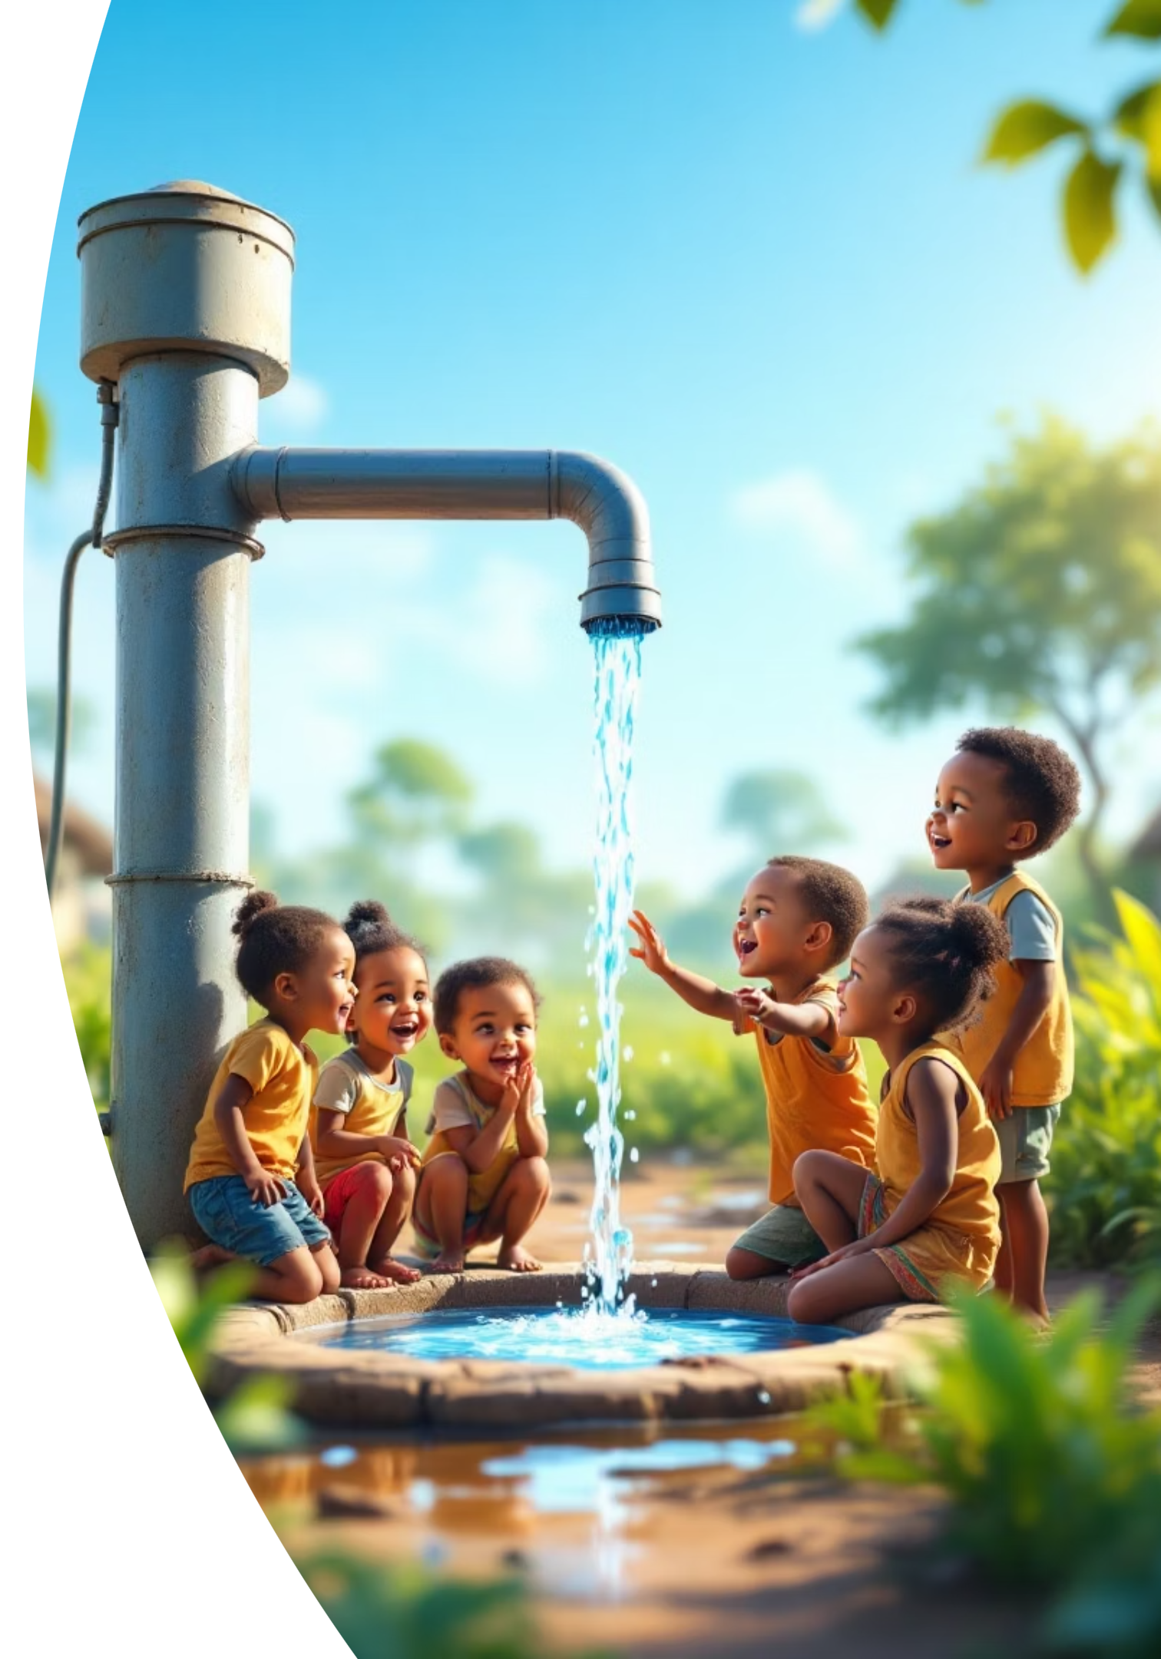
Safe Water Access and Child Mortality Project
Team Members: Yvette, Janviere, Josiane, Solange

Slide 2


Problem Statement & Objectives
The Problem
Many children in low-income countries die from preventable causes often linked to lack of clean water and sanitation.
Despite progress, significant gaps remain between regions and income groups.
Can better access to clean water reduce child deaths?

Slide 3
Project Objectives
1
2
Analyze Trends
Assess Correlation
Examine water and sanitation access patterns by country, region, and income group.
Evaluate the relationship between improved WASH services and under-five mortality rates.
3
4
Identify Vulnerable Areas
Support Policy
Pinpoint regions and countries where children face the highest risk.
Provide data-informed recommendations for water and sanitation infrastructure investment.

Slide 4
What We Did: Data Analysis Process
Reporting
Analysis
Created interactive dashboard visualizing WASH access.
Data Acquisition
Conducted EDA with charts and statistical tests
Downloaded WHO/UNICEF JMP and World Bank WDI datasets (2000–2023)
Found significant correlations: Water Access vs. Mortality (r = -0.444)
Drafted policy recommendations based on findings
Explored structure: Water %, Sanitation %, Mortality, Income Group, Region
Aligned with SDGs 3 (Health) and 6 (Clean Water)
Sanitation vs. Mortality (r = -0.511)

Slide 5

Key Findings & Recommendations
What We Found
Policy Recommendations
Countries with higher WASH access have much lower child mortality
Invest in WASH infrastructure in low-income, underserved areas
Strong negative correlation: As WASH improves, under-5 deaths fall
Target high-mortality regions for focused improvement
Rural and low-income regions are still far behind in access
3. Use real-time monitoring tools to track SDG progress
Clean water saves lives. Data shows us how. Let's turn this evidence into action — especially where it matters most.

